Slide 1




University of Cincinnati
Ken Stratman
Enrollment Services 513-556-1000 enrollmentservices@uc.edu @UCenrollment
Resources and drop-in hours: uc.edu/enrollment-services

Slide 2

FINANCIAL AID 101 AGENDA
Scholarships and Work Study
Cost of college
Financial Success Tips

Slide 3

What is Financial Aid?
Financial aid is money to help pay for college.
Examples of Sources:
Colleges or Universities
Federal Government
State Government
Community and Religious organizations
Student or parent employer

Slide 4
How is financial aid determined?
Your financial need is determined by the data provided on your FAFSA.
Your financial "need" determines your eligibility for need-based financial aid funds.
A college alone may not be able to offer enough aid to meet your financial need. Keep this in mind when considering which college to choose, whether you will live on or off campus, etc.

Slide 5

How Do I Apply for Aid?
Steps for Completing the FAFSA
Start at studentaid.gov
Both student and parent create their own FSA ID
Start the FAFSA form
2026-27 FAFSA is available Oct 1, 2025
List up to 20 schools
Enter requested information
Sign & submit your FAFSA

Slide 6
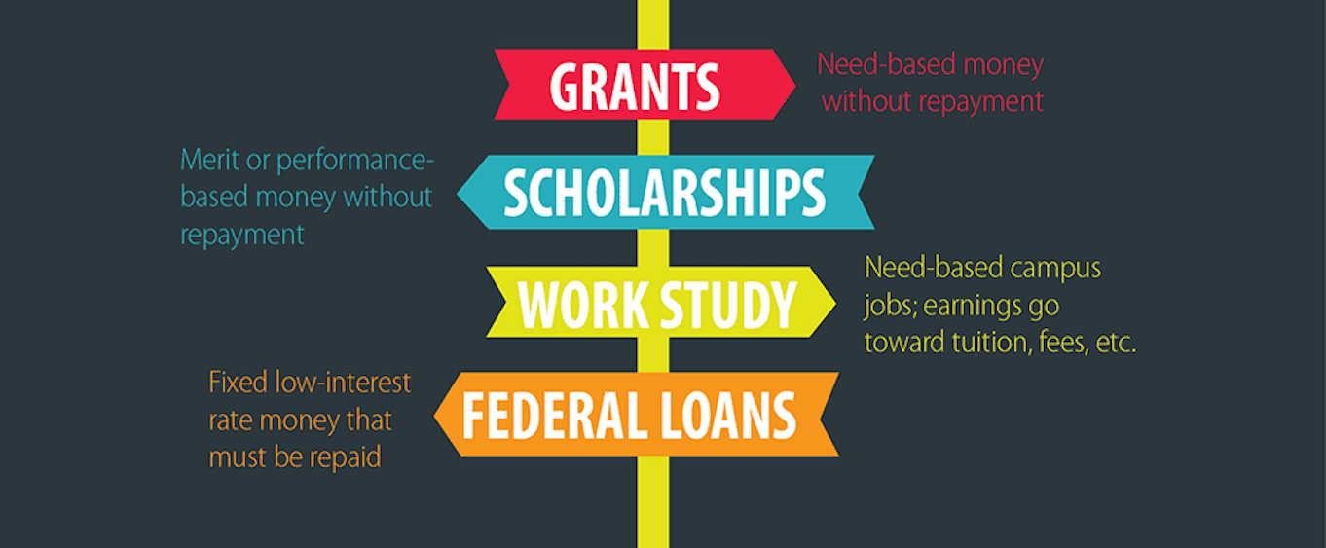
Types of Financial Aid

Slide 7

Grants – Free Money
Grants - awarded based on Financial Need from the results of your FAFSA. Free funds that do not have to be repaid (in most cases).
Students may see Grants such as:
Federal Pell Grant
Supplemental Educational Opportunity Grant
Ohio College Opportunity Grant
Some programs and colleges have additional grant funds
Notes:
Institutional or need grants can
UCC and UCBA do not qualify

Slide 8

Scholarships Two Primary Types: Institutional and Private
How are scholarships awarded?
Full academic profile.
Scholarships have their own criteria.
Do not have to be repaid.
Renewable scholarships usually have a GPA requirement.
Never Stop applying for scholarships.
Use reputable sources.
Scholarship essays are your time to shine. Speak to what makes you unique.

Slide 9
Scholarship Searches​
Information via the Web: ​
uc.edu/enrollment-services
fastweb.com​
scholarshipamerica.org ​
cincinnatischolarshipfoundation.org​
collegeboard.com​
collegexpress.com​
munozfoundation.org​
uncf.org​
Libraries​.
High school counselors​.
Hometown organizations, churches, etc.​
UC Scholarships may require community service.
UC Scholarships are awarded using the full academic profile.

Slide 10

Employment Federal Work Study (FWS) – Part Time Jobs
Your college & Department of Ed each pay a percentage of your salary.
Earnings are paid directly to the student as they work via paycheck.
Not every student will qualify for FWS and there are limited openings.
Can reduce reliance student loans.

Slide 11
Loans Overview
MUST BE REPAID
Can be federal student loans, parent loans, alternative loan or a combination.
Repayment begins 6 months after graduation (or when enrollment falls below ½ time) on federal student loans

Slide 12
Types of Loans
Subsidized Federal Student Loans:
The interest is paid by the Department of Ed while the student is in school at least ½ time (6 hours or more).
Payments are deferred as long as the student attends ½ time.
Unsubsidized Federal Student Loans:
The interest accrues on the loan while the student is in school at least ½ time (6 hours or more).
Payments are deferred as long as the student attends ½ time.
Parent Plus Loans:
Parent serves as the borrower.
Approval is based on parent’s credit history.
If parent is denied a plus loan due to credit, then the student could be eligible for additional unsubsidized loans.
Alternative (Private) Education Loans:
Loans taken out by parent or student.
Approval is based on credit history.
Be mindful of interest rates and repayment terms.

Slide 13
What will college cost?
Direct Costs:
Billed by or paid directly to the college, such as tuition, e-books or on-campus housing.
Indirect Costs:
Necessary expenses that could include transportation, books, off-campus housing, computer, personal care items and other items that are not paid to the college.

Slide 14
Cincinnati Tuition Guarantee Policy
Fees Included in UC’s Cincinnati Tuition Guarantee
Campus Life / Distance–Learning Fee.
General Fee.
Information Technology and Instructional Equipment Fees.
Instructional Fee.
Housing and Meal Plan Charges (see the section below for details).
Duration of UC’s Cincinnati Tuition Guarantee
Four-year programs are comprised of 12 consecutive semesters.
Five- year programs are comprised of 15 consecutive semesters.
Estimated Tuition and Fees for 2025 – 2026 Academic Year
Uptown Campus $600 per credit $7197 per full-time semester.
UC Clermont $282 per credit $3476 per full-time semester.
UC Blue Ash $366 how per credit $3708 per full-time semester.
Housing & Meal Plan Charges for 2054 – 2026 Academic Year
Rooms range from $4,179 – $8,669 per semester.
Meal plans range from $2696 (unlimited meals).
Freshmen must purchase the unlimited meal plan their first year.

Slide 15
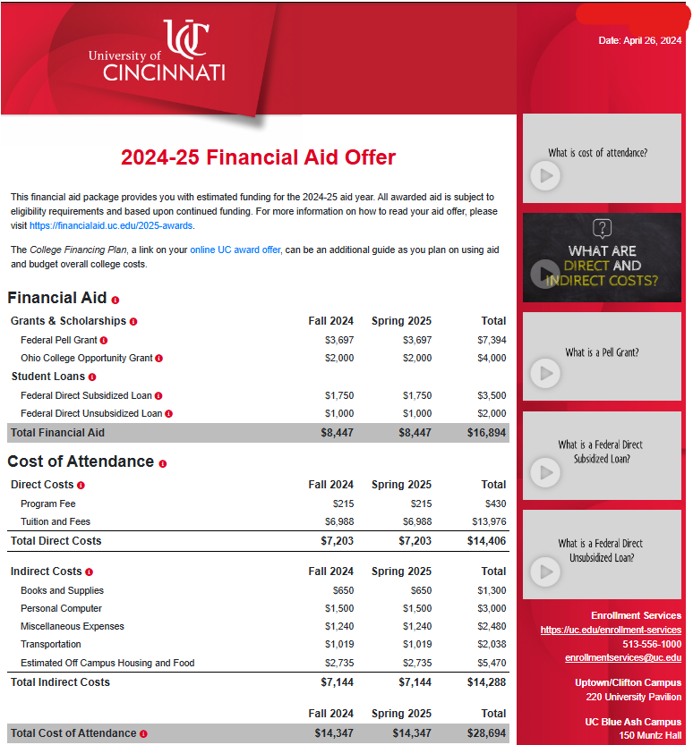
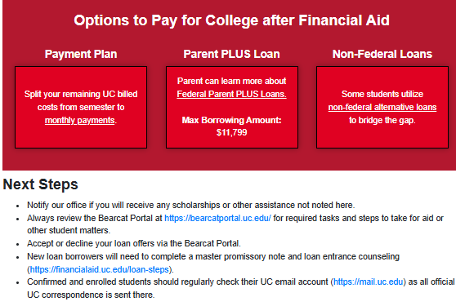
Financial Aid Awards & Cost Overview

Slide 16
UC Billing Process
Bills available 6 weeks prior to semester start.
Bills always due 5 days before first day of semester.
Fall 2025 bill due date: August 20

Slide 17

UC Payment Options
UC Offers a 3 Payment Plan Every Semester
529 Plans
Employer Tuition Benefits

Slide 18

Can I afford it? Make a plan today
Talk to your parents about what they are willing to spend/borrow.
Know where your money is coming from before you start school.
Save for your education.
Study hard and get good grades now.
Apply for scholarships.

Slide 19
College Financial Success Tips
Make a plan for covering college cost
Loans are offered at maximum eligibility, only borrow what you need.
Utilize Federal Work Study and/or work part-time.
Compare book prices.
Anticipate upcoming expenses with a "rainy day" fund.
Control Impulse spending.
Build an emergency fund.
Take advantage of Financial Literacy tools while you are in school.
Take 15 credits each semester to graduate on time (and save money)
12 Credits per semester = 10 semesters to graduate.
15 Credits per semester = 8 semesters to graduate.

Slide 20
Questions?
Ken Stratman
Enrollment Services 513-556-1000 enrollmentservices@uc.edu @UCenrollment
Resources and drop-in hours: uc.edu/enrollment-services

